Slide 1
NLP Introduction lecture 01.1
Branko Žitko

Slide 2
Introduction
Products derived from the application of Natural Language Processing (NLP)
Alexa
Siri
Google Translate
NLP is mostly currently based on statistical methods with or without insights from linguistics to understand text for the sake of solving real-world tasks.
Understanding of text is mainly deriver by transforming text to useable computational representation.
discrete or continuous combinatorial structures: vectors, tensors, graphs, trees…

Slide 3
Introduction
Learning of representations from data is the subject of machine learning (from 1990's)
Deep learning became highly effective for artificial intelligence (AI) tasks in NLP (from 2010's)
Deep learning enables efficiently learning representations from data using an abstraction called the computational graphs and numerical optimization techniques.
PyTorch is computational graph framework for implementing deep learning algorithms.
Supervised learning is learning with labeled training examples.

Slide 4
Contents
Supervised learning paradigm
Encoding inputs for the learning tasks.
Computational graphs
Basics of PyTorch.

Slide 5
Supervised Learning Paradigm
Supervised learning paradigm refers to cases where the ground truth for the targets (what's being predicted) is available for the observations.
In document classification,
target is a categorical label, and
the observation is a document.
In machine translation,
the observation is a sentence in one language, and
the target is a sentence in another language.

Slide 6
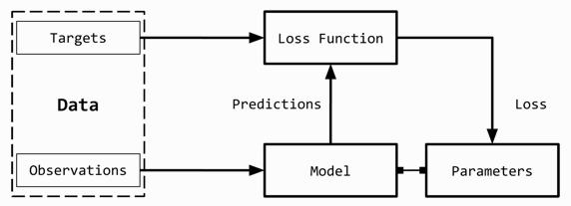
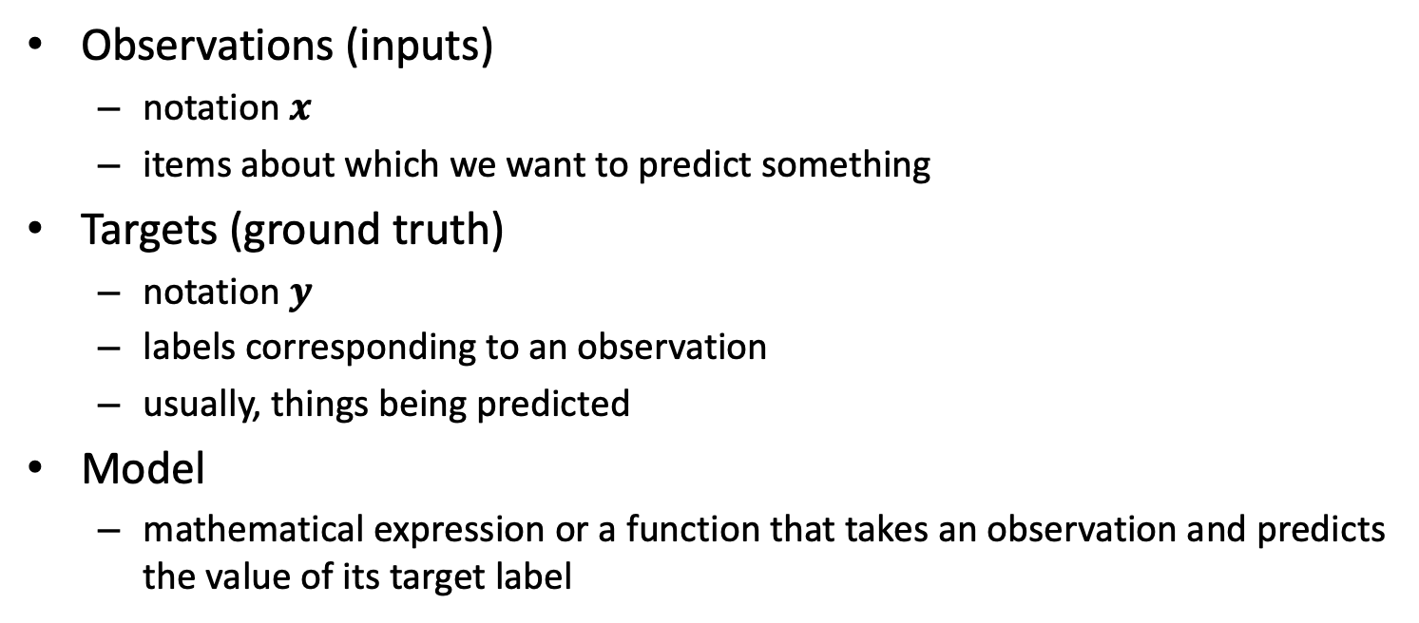
Supervised Learning Paradigm
Observations (inputs)
notation $x$
items about which we want to predict something
Targets (ground truth)
notation $y$
labels corresponding to an observation
usually, things being predicted
Model
mathematical expression or a function that takes an observation and predicts the value of its target label

Slide 7
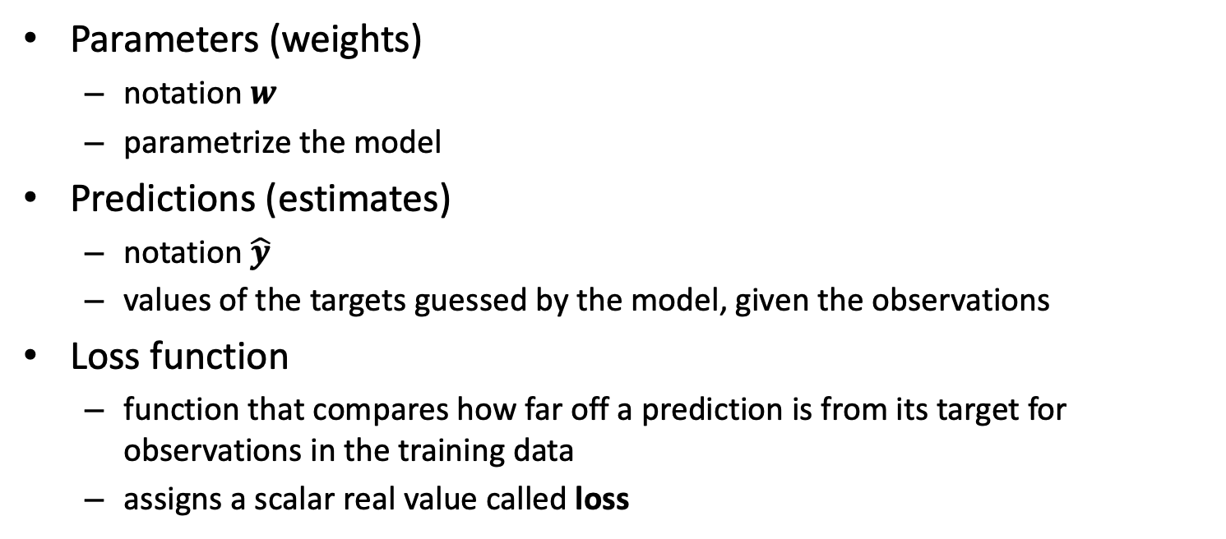
Supervised Learning Paradigm
Parameters (weights)
notation $w$
parametrize the model
Predictions (estimates)
notation $\hat{y}$
values of the targets guessed by the model, given the observations
Loss function
function that compares how far off a prediction is from its target for observations in the training data
assigns a scalar real value called loss

Slide 8
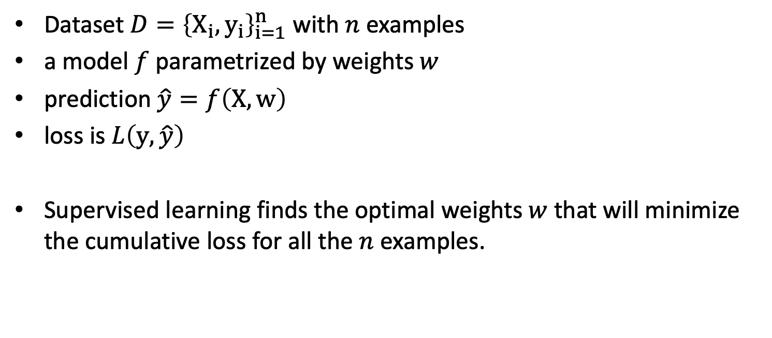
Supervised Learning Paradigm
Dataset $D={\left\{X_{i}, y_{i}\right\}}_{i=1}^{n}$ with $n$ examples
a model $f$ parametrized by weights $w$
prediction $\hat{y}=f\left(X, w\right)$
loss is $L\left(y,\hat{y}\right)$
Supervised learning finds the optimal weights $w$that will minimize the cumulative loss for all the $n$ examples.

Slide 9
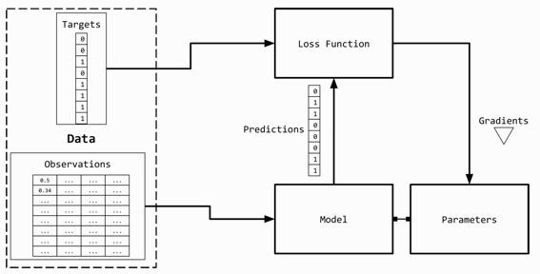
Observation and Target Encoding
Observations (text) must be represented numerically to use them in conjunction with the machine learning algorithms.
A simple way to represent text is a numerical vector.

Slide 10
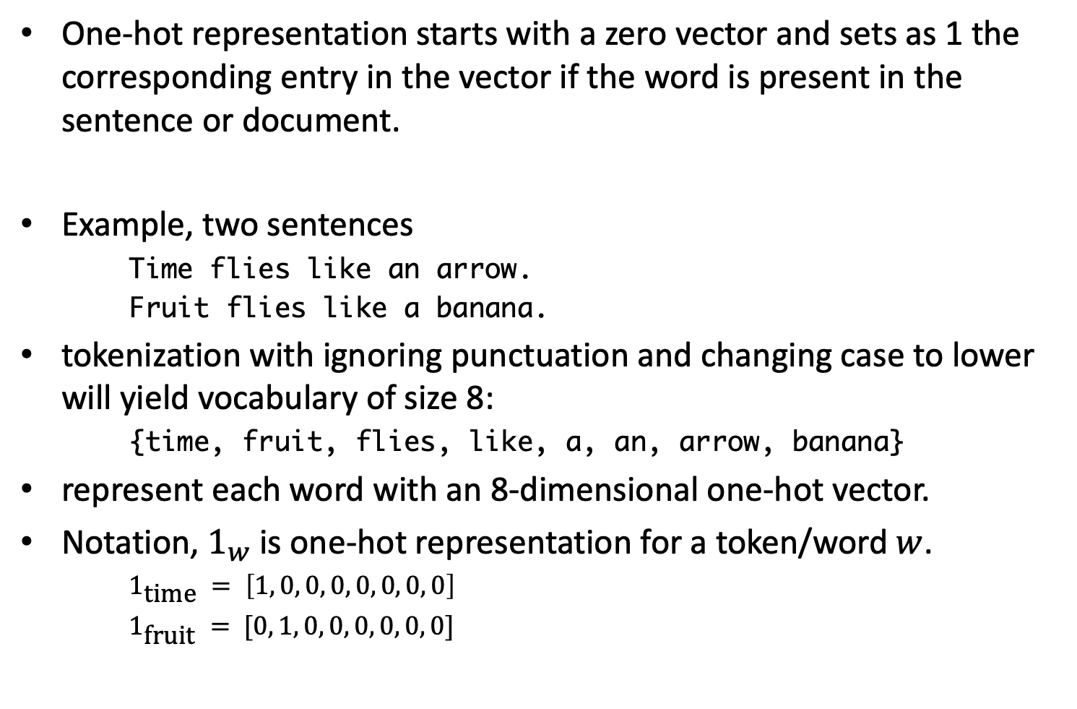
One-hot representation
One-hot representation starts with a zero vector and sets as 1 the corresponding entry in the vector if the word is present in the sentence or document.
Example, two sentences
Time flies like an arrow.
Fruit flies like a banana.
tokenization with ignoring punctuation and changing case to lower will yield vocabulary of size 8:
{time, fruit, flies, like, a, an, arrow, banana}
represent each word with an 8-dimensional one-hot vector.
Notation, $1_{w}$ is one-hot representation for a token/word $w$.
$1_{\text{time}} = \left[1, 0, 0, 0, 0, 0, 0, 0\right]$
$1_{\text{fruit}} = [0, 1, 0, 0, 0, 0, 0, 0]$

Slide 11
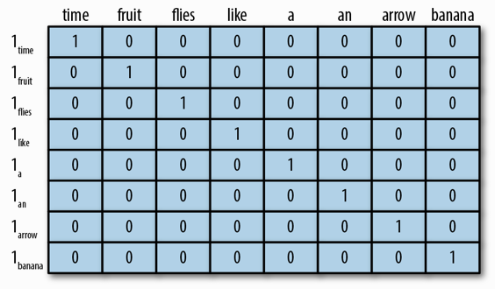

One-hot representation
One-hot representation for encoding the sentences "Time flies like an arrow" and "Fruit flies like a banana."
The binary encoding for phrase "like a banana" would be:
$[0, 0, 0, 1, 1, 0, 0, 1]$

Slide 12
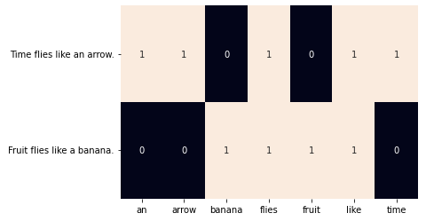
One-hot representation
from sklearn.feature_extraction.text import CountVectorizer
import seaborn as sns
corpus = ['Time flies like an arrow.',
'Fruit flies like a banana.']
one_hot_vectorizer = CountVectorizer(binary=True, lowercase=True)
one_hot = one_hot_vectorizer.fit_transform(corpus).toarray()
vocab = one_hot_vectorizer.get_feature_names_out()
sns.heatmap(one_hot, annot=True, cbar=False,
xticklabels=vocab, yticklabels=corpus)

Slide 13
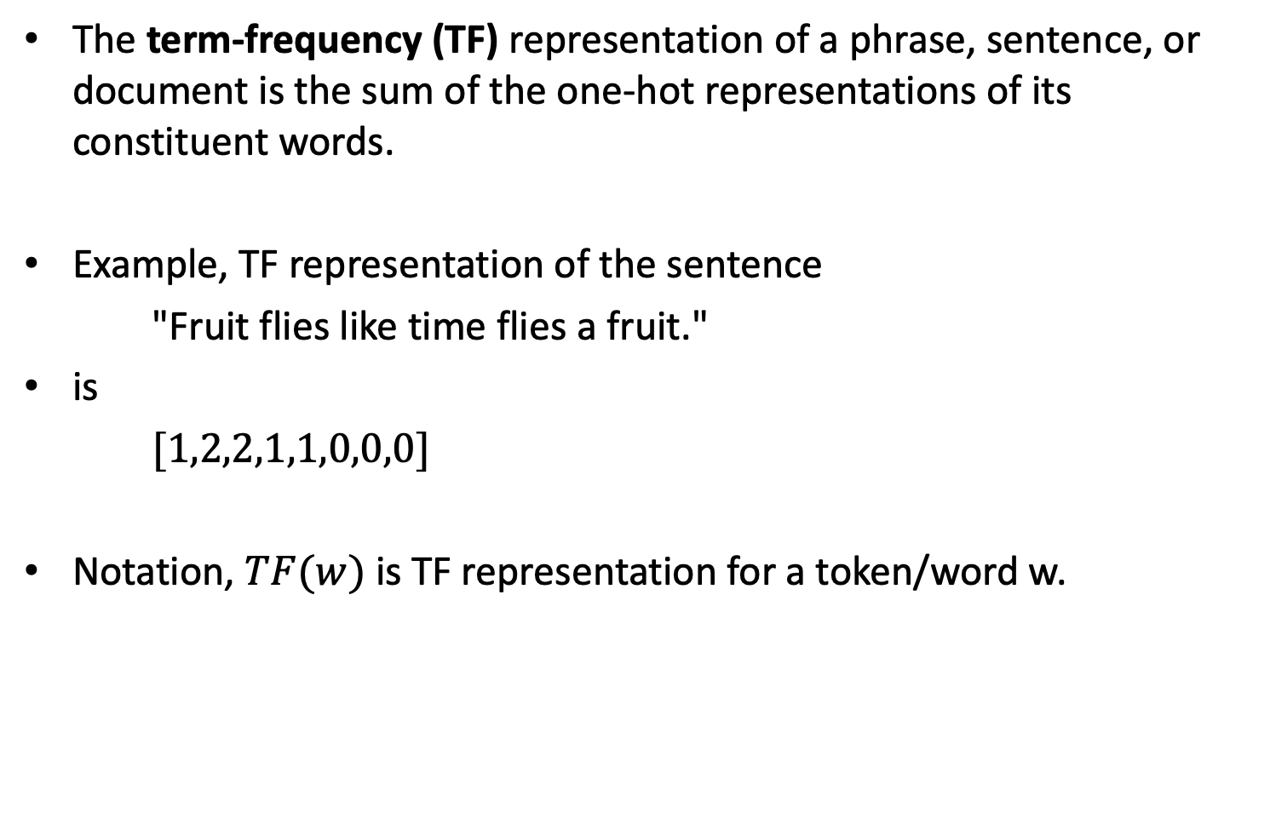
TF representation
The term-frequency (TF) representation of a phrase, sentence, or document is the sum of the one-hot representations of its constituent words.
Example, TF representation of the sentence
"Fruit flies like time flies a fruit."
is
$[1,2,2,1,1,0,0,0]$
Notation, $TF(w)$ is TF representation for a token/word w.

Slide 14
TF-IDF representation
Consider a collection of patent documents.
You would expect most of them to contain words like "claim", "system", "method", "procedure", and so on, often repeated multiple times.
The TF representation weights words proportionally to their frequency.
However, common words such as "claim" do not add anything to our understanding of a specific patent.
Conversely, if a rare word (such as "tetrafluoroethylene") occurs less frequently but is quite likely to be indicative of the nature of the patent document, we would want to give it a larger weight in our representation.
The Inverse-Document-Frequency (IDF) is a heuristic to do exactly that.

Slide 15
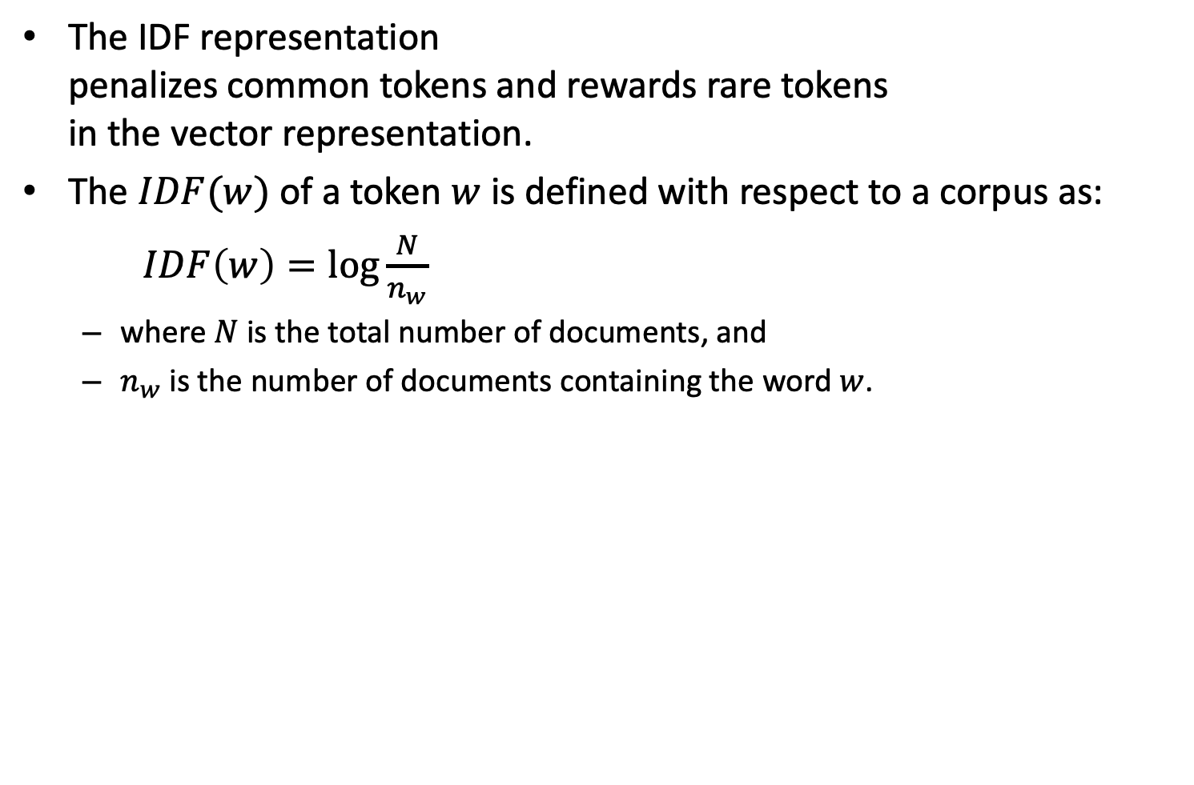
TF-IDF representation
The IDF representation penalizes common tokens and rewards rare tokens in the vector representation.
The $IDF(w)$ of a token $w$ is defined with respect to a corpus as:
$IDF\left(w\right)=\log{\frac{N}{n_{w}}}$
where $N$ is the total number of documents, and
$n_{w}$ is the number of documents containing the word $w$.

Slide 16
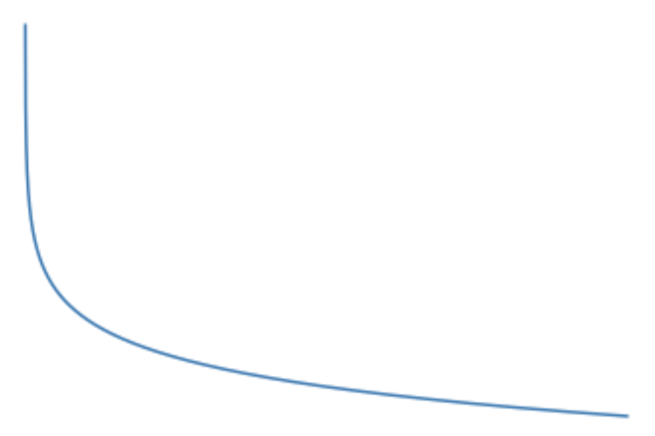





TF-IDF representation
If a word $w$ is common and occurs in every document, its $IDF\left(w\right)= 0$
if a word $w$ is rare and occurs in only one document, its $IDF\left(w\right)=\log\left(N\right)$ will be the maximum possible value.
The TF-IDF score is simply the product
$TF(w) ∗ IDF(w)$
$$IDF\left(w\right)$$
rare $w$
common $w$
$$n_{w}$$

Slide 17
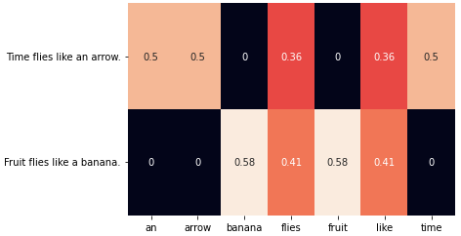
TF-IDF representation
from sklearn.feature_extraction.text import TfidfVectorizer
import seaborn as sns
corpus = ['Time flies like an arrow.',
'Fruit flies like a banana.']
tfidf_vectorizer = TfidfVectorizer(lowercase=True)
tfidf = tfidf_vectorizer.fit_transform(corpus).toarray()
vocab = tfidf_vectorizer.get_feature_names_out()
sns.heatmap(tfidf, annot=True, cbar=False,
xticklabels=vocab, yticklabels=corpus)
How sklearn’s Tfidfvectorizer Calculates tf-idf Values
Notes:
Smooth IDF with L2 normalization

Slide 18
Target Encoding
The exact nature of the target variable can depend on the NLP task being solved.
In cases of machine translation, summarization, and question answering
the target is also text and is encoded using approaches such as one-hot encoding.
Predicting one of a fixed set of categorical labels
usage a unique index per label,
can become problematic when the number of output labels is too large.
Predicting a numerical value from a given text.
assign a numeric grade for English essay
predict a numerical star rating for a given restaurant review snippet
predict the user’s age group for a given user’s tweets
Several approaches exist to encode numerical targets
Placing the targets into categorical "bins" - for example, 0-18, 19-25, 25-30, and so on for ages is a reasonable approach.

Slide 19
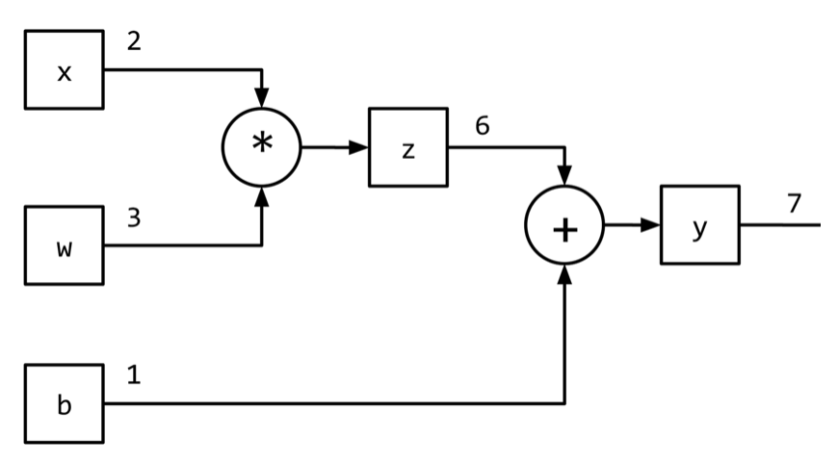

Computational Graph
The expression
$y=wx + b$
can be written as two subexpressions
$z=wx$ and $y=z + b$
Representation of computational graph using a direct acyclic graph (DAG)

